Slide 1
How to Use the Demo Code
3D Print Gripper Project

Slide 2
Purpose of the GUI Development
Design a Python GUI code
Control servo via serial port (USB) and Arduino Mega2560
Utilize a camera to detect hand gestures
Utilize the detected hand gesture to control the opening and closing of the gripper

Slide 3
What we need to download
Demo Code
Python GUI code
Arduino Code
Python 3(now is 3.11 or 3.12)
Optional
VsCode
Extension: Python Extension Pack(7)

Slide 4
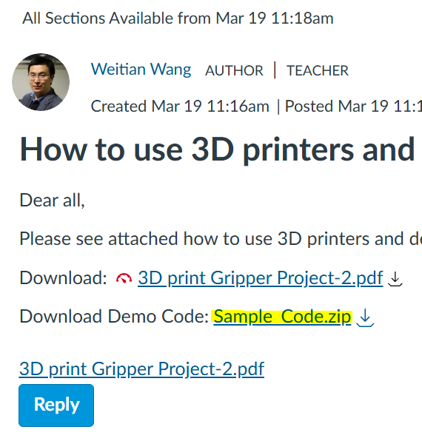
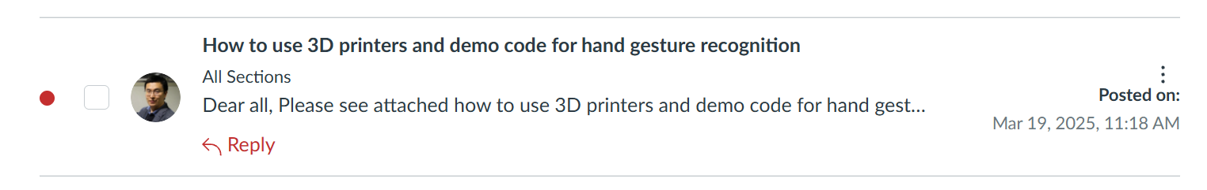
Servo Control Demo Code
Provided via Canvas Announcement
No need to change the Arduino code
Work on the *.py code

Slide 5
Python
Install Python 3 64bit
Open the CMD or Terminal
Type py -0
If (Number_of_Python ==1):
Type(pip install pyserial customtkinter mediapipe opencv-contrib-python )
Else:
Type(pip3 install pyserial customtkinter mediapipe opencv-contrib-python )

Slide 6
Arduino Code and Board
Connect the Mega2560 to your computer
Open Arduino IDE
Upload the Arduino code
Check your port number and record it (optional)
Windows: COMx
MacOS: /dev/cu.usbmodemXXXX

Slide 7
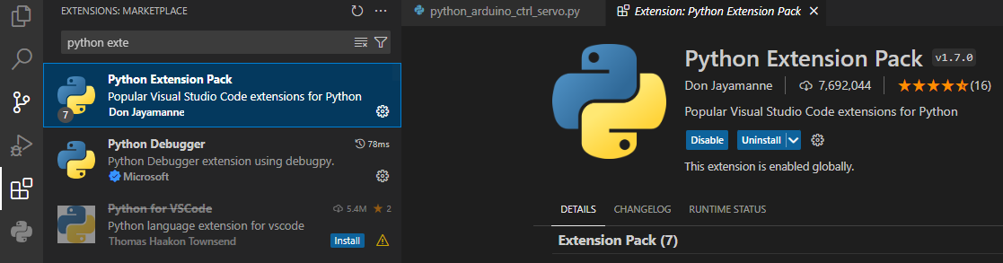
Install VsCode
Install Extension
Python Extension Pack(7)

Slide 8
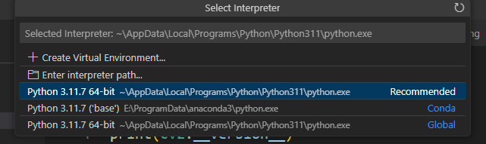

Open The xxx.py code in VsCode
Click a small button in the right corner
Select Python 3.x.x

Slide 9
Now we look at the x.py code
(In the most recent code, the port detection is automatic, so you can skip this step if the auto version works)
Find the line of Code
Change the port number to your recorded port
In the picture, it is “COM4”

Slide 10
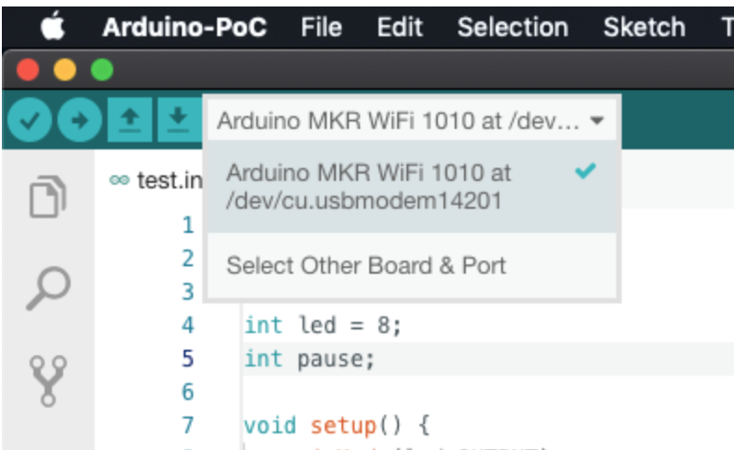
How to find the Serial ports for Python code on Mac OS
https://www.mathworks.com/help/supportpkg/arduinoio/ug/find-arduino-port-on-windows-mac-and-linux.html
https://stackoverflow.com/questions/54584029/how-to-determine-port-number-of-arduino-for-pyserial-in-macos
The name of the ports seems to be "usbmodem14201"
However, in the Mac OS, the actual full name is "/dev/cu.usbmodem14201 ".
Please use the methods to identify the full name of serial ports if your team only has Mac OS computers or as you prefer.(In the IDE of Arduino, you probably could see the full name.)

Slide 11
Click Run
Keep the Mega2560 Connected
How to connect the Servo
Red to 5V
Dark to Ground
Yellow to A2(if you don’t change the Arduino code)

